Slide 1
Quick Review
The demand and supply curves for housing
Movement along the curve vs. the shift of the curve
Elasticity of housing supply: How much the quantity supplied of changes when the price changes

Slide 2
Dynamic and Durable Housing
RE420: URBAN AND REGIONAL ECONOMICS

Slide 3
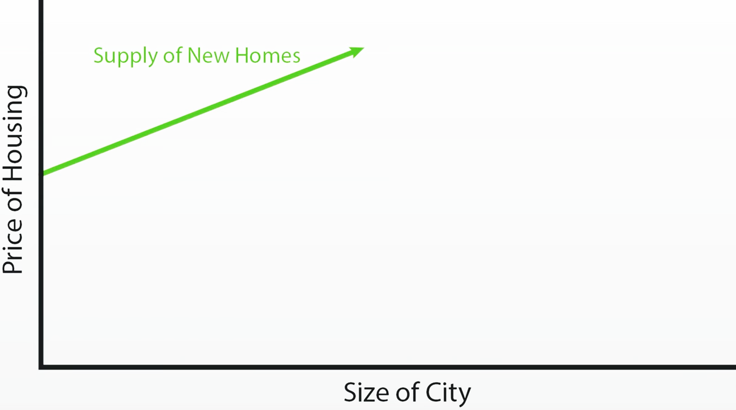

Slide 4
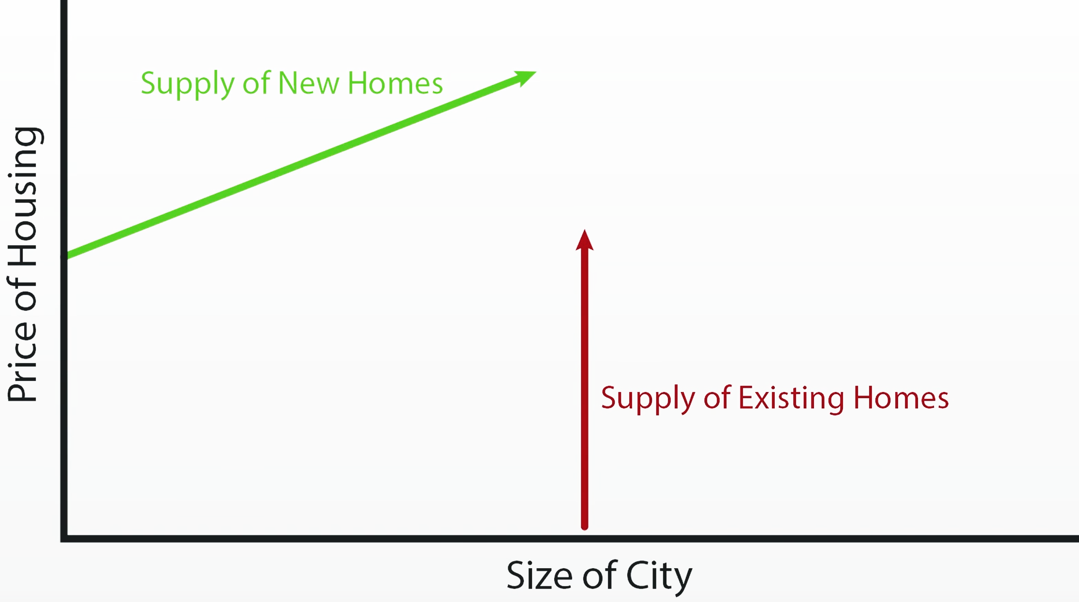

Slide 9
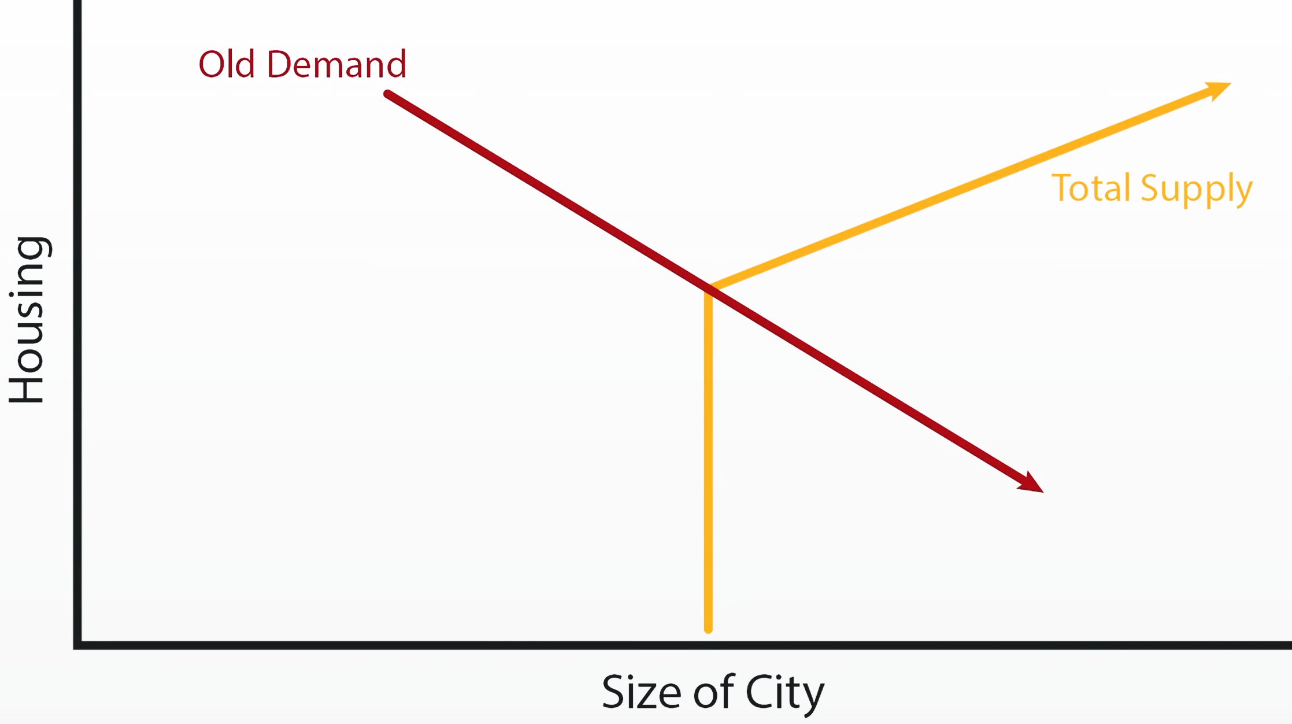
Price

Slide 10
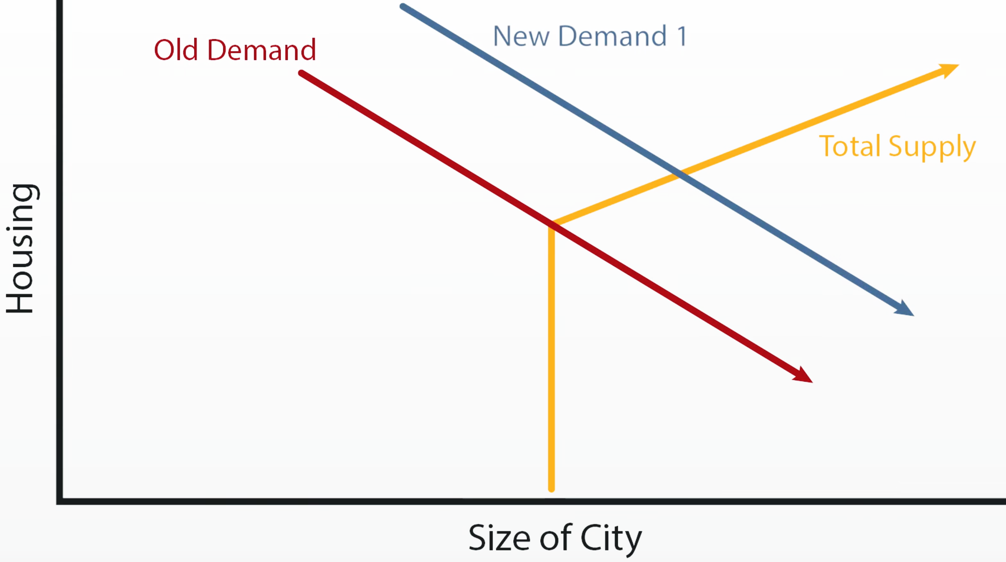
Price

Slide 11
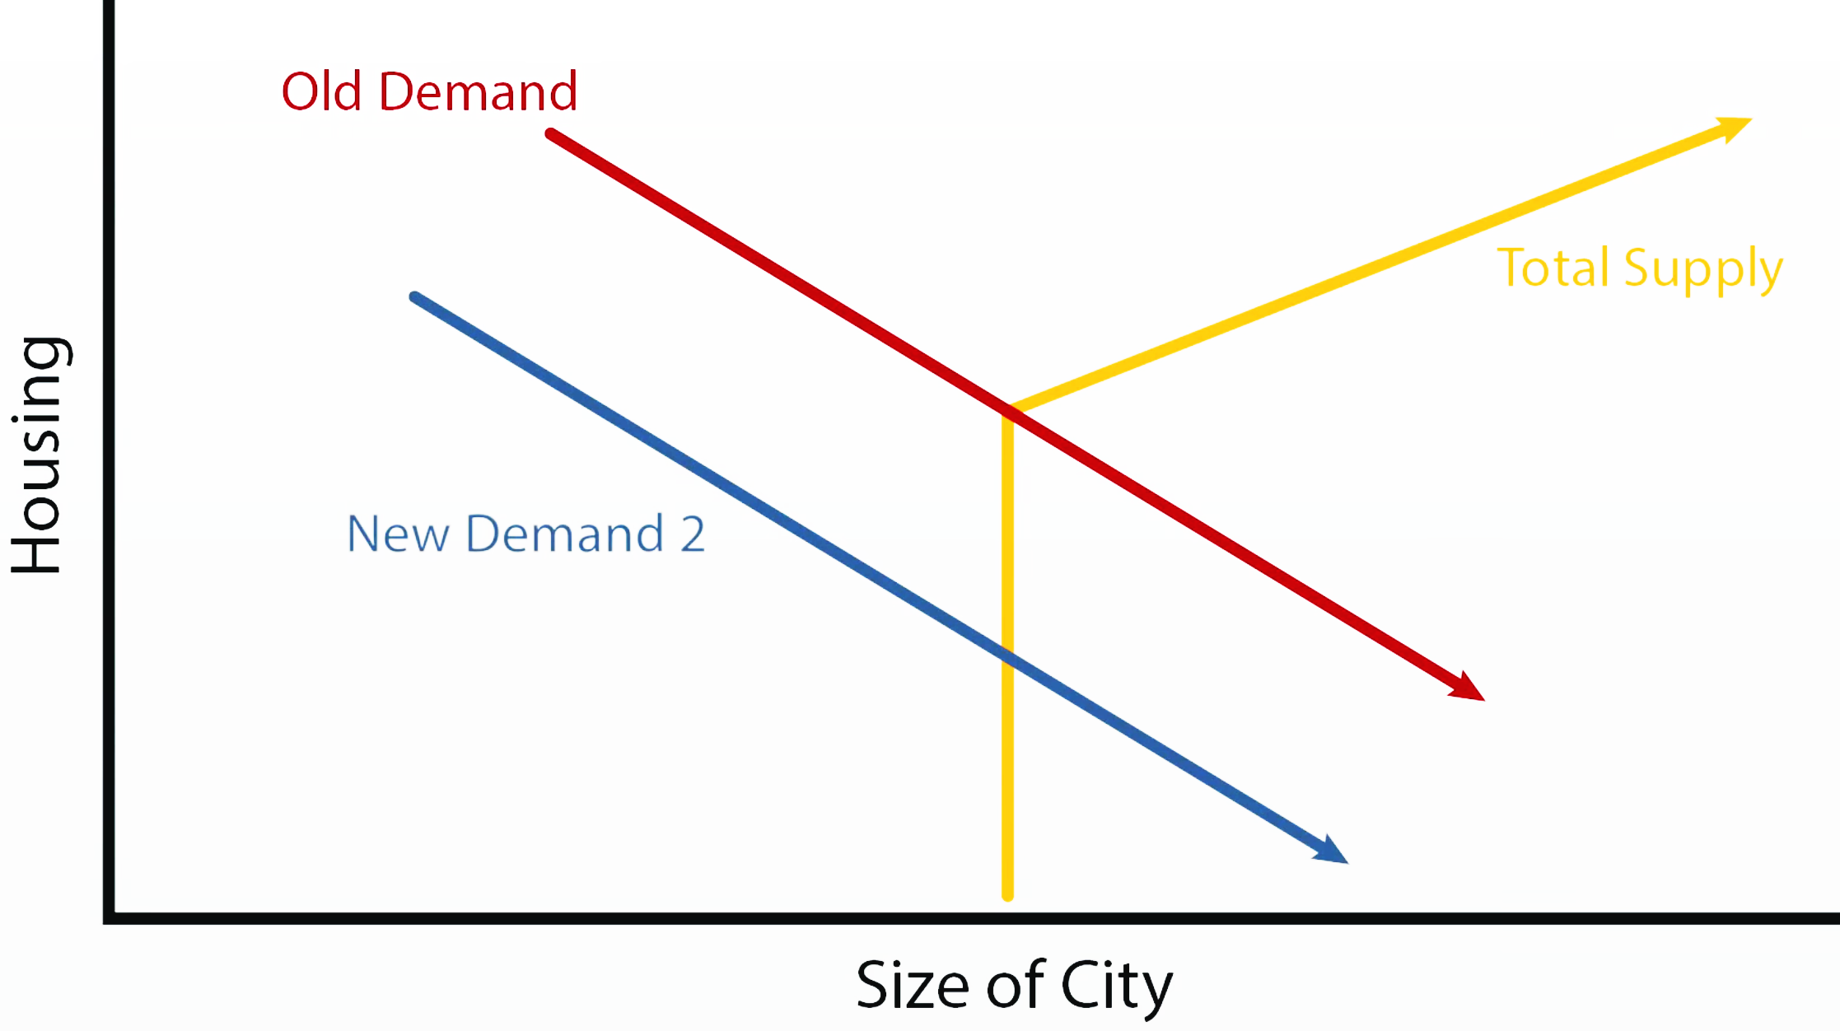
Price

Slide 12
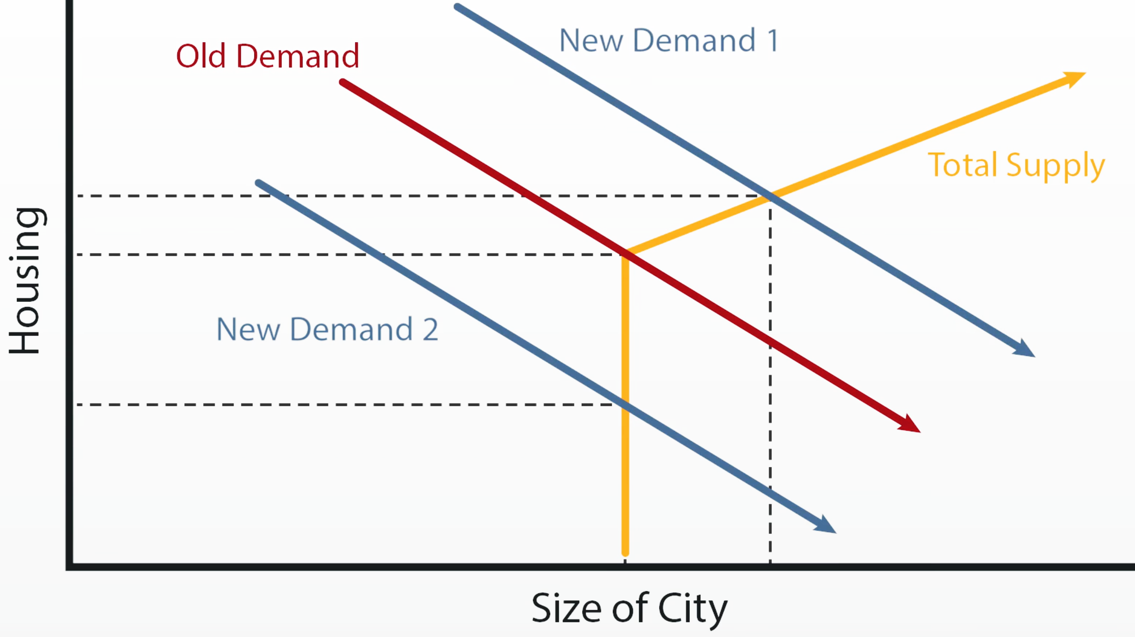
Price

Slide 13
Three Types of Housing Markets

Slide 14
Market Type 1: Elastically-supplied markets
Little or no constraints on builders supplying new housing units whenever they can cover their fundamental production costs
Most common in interior markets of the U.S.
Especially the Sunbelt region of the South and Southwest, e.g., Atlanta, Phoenix, Dallas, and Houston

Slide 15
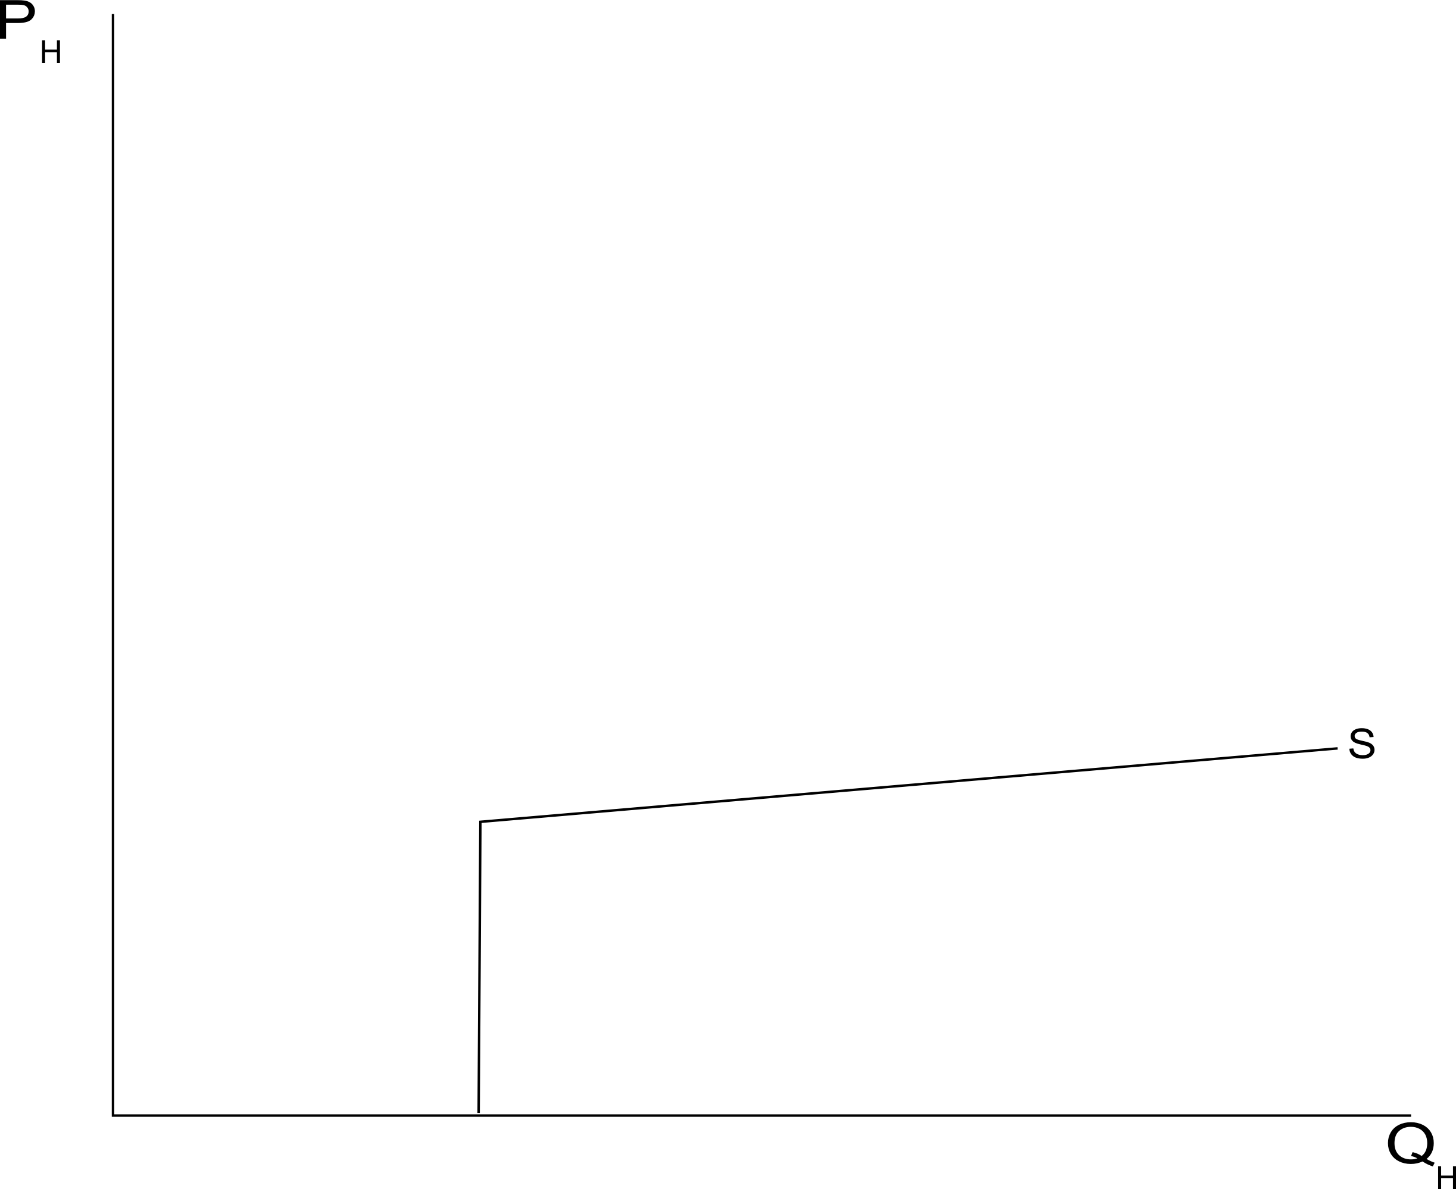

Slide 16
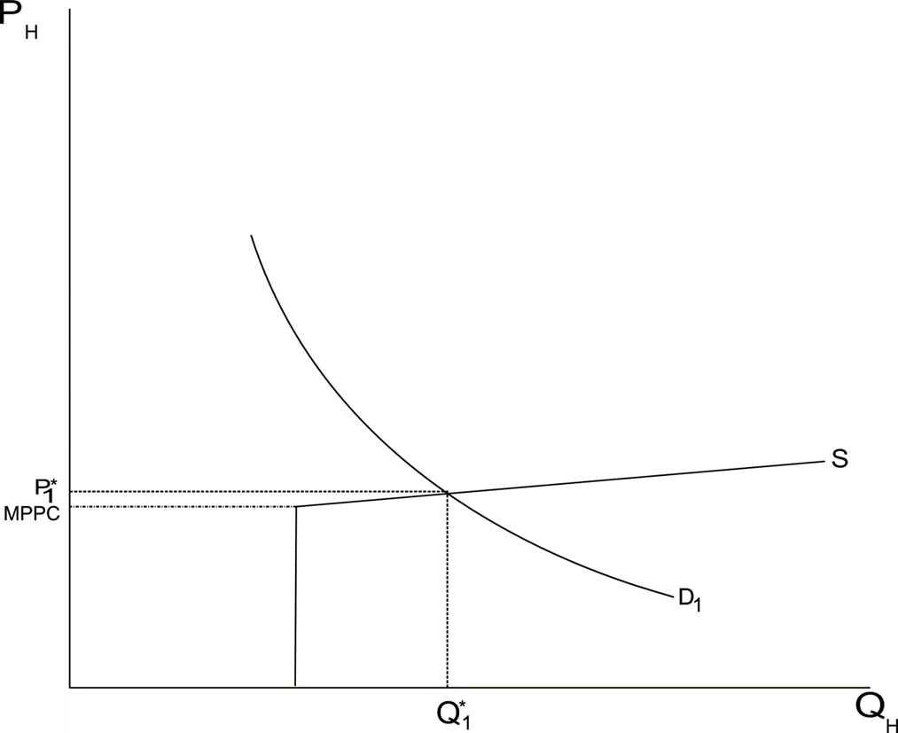
minimum profitable production costs

Slide 17
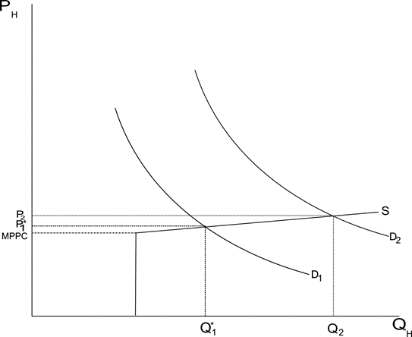

Slide 18
Market Type 2: Inelastically-supplied markets
Substantial constraints on builders prevent them from supplying new housing units whenever they can cover their fundamental production costs
Most common in coastal markets of the U.S.
New York City, Los Angeles, Chicago, Boston, Washington DC, San Francisco, Seattle
International markets include London, Hong Kong, Shanghai
Land values are very high in these markets

Slide 19
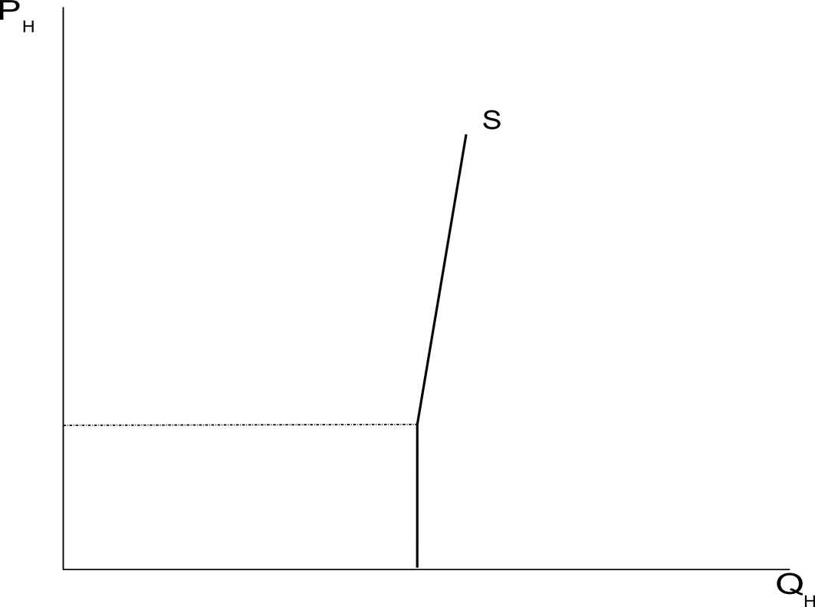

Slide 20
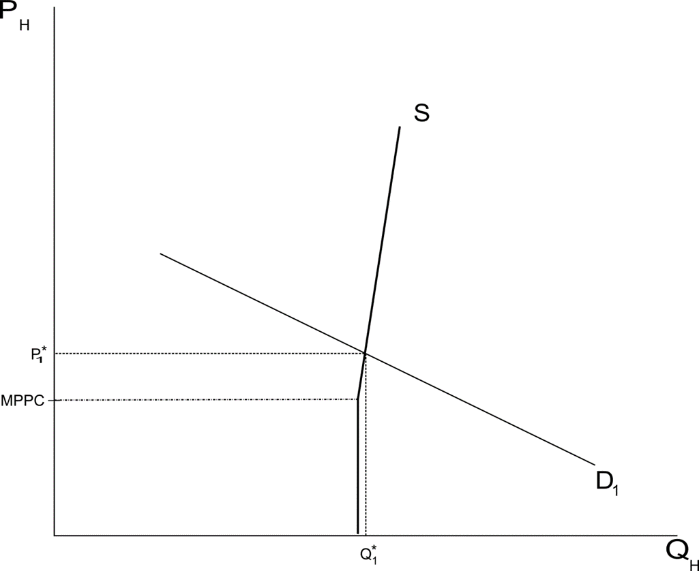

Slide 21
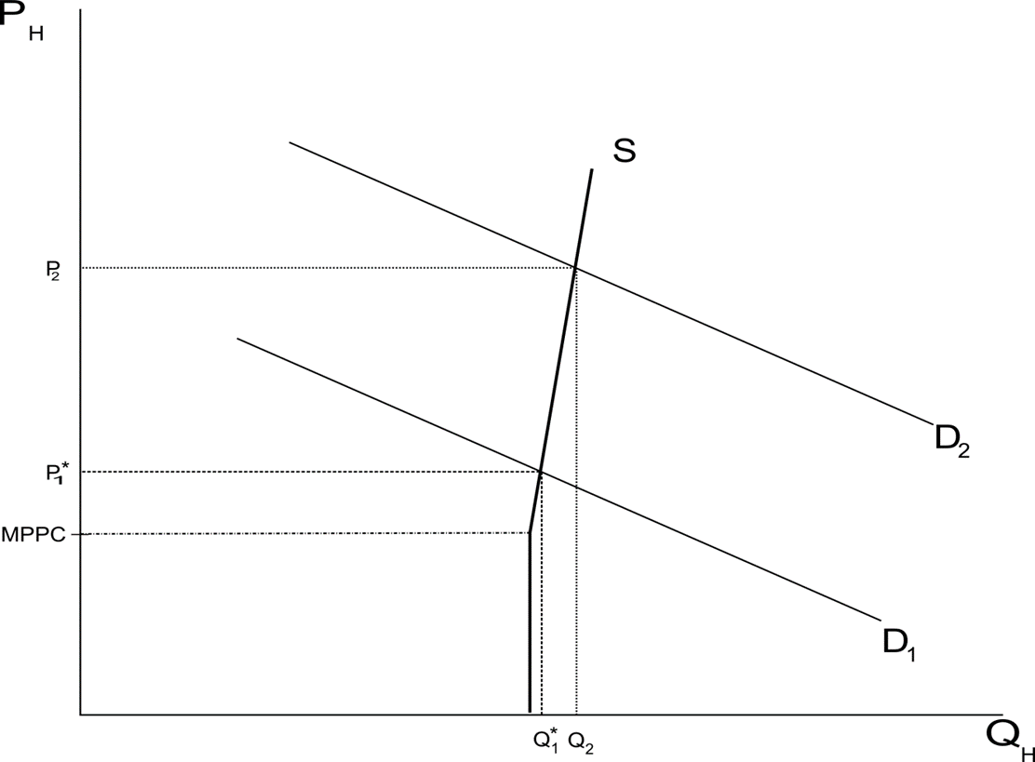

Slide 22
Market Type 3: Declining markets

Slide 23
Market Type 3: Declining markets
Declining markets with prices below fundamental production costs. No supply side constraints on development, but prices are so low that there is no economic incentive to build.
Most common in the Rustbelt region of the U.S.
Declining auto manufacturing and steel production towns such as Detroit and Cleveland
Land is very cheap in these markets

Slide 24
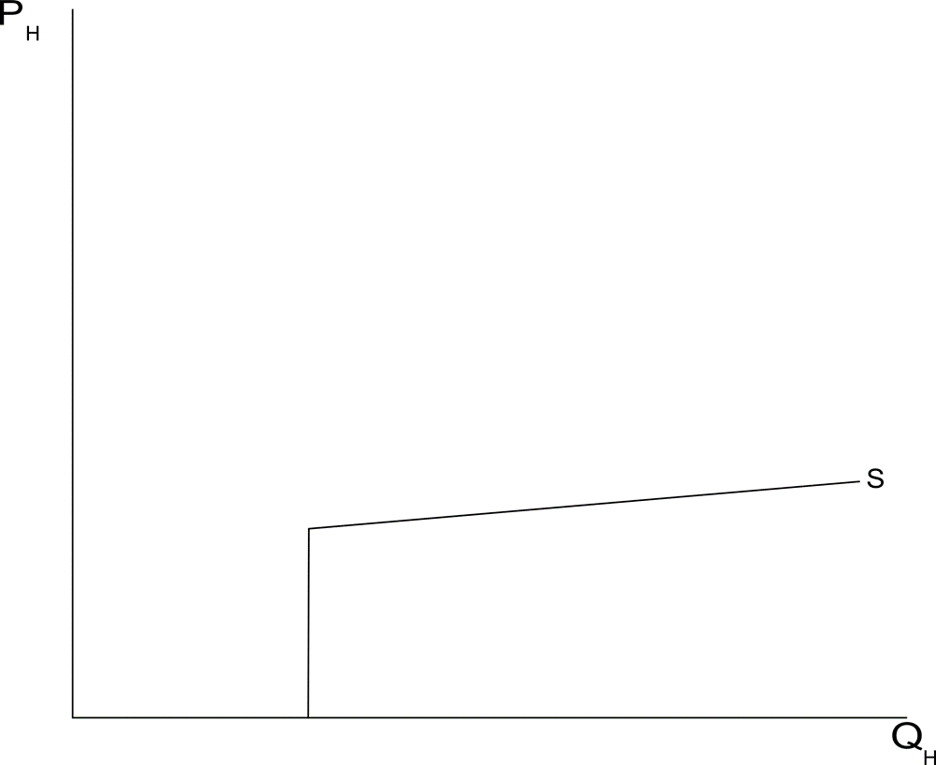

Slide 25
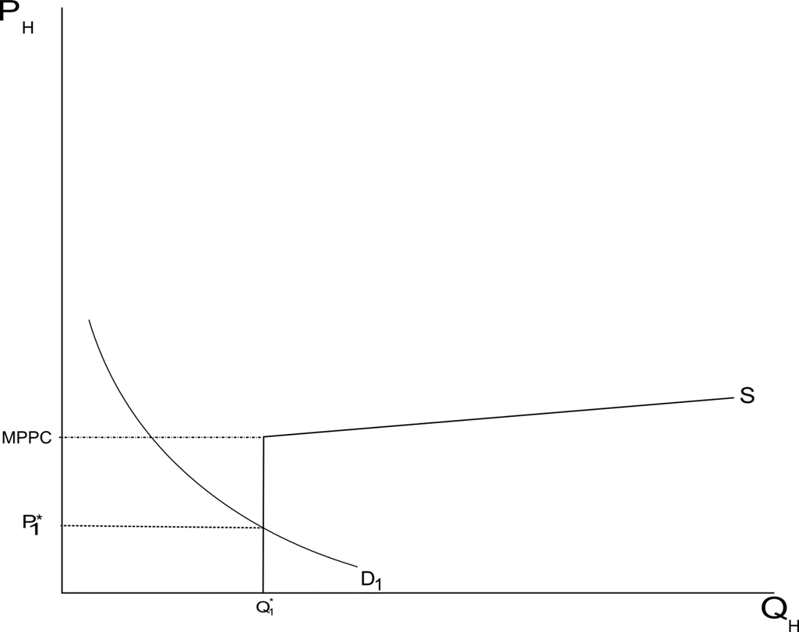

Slide 26
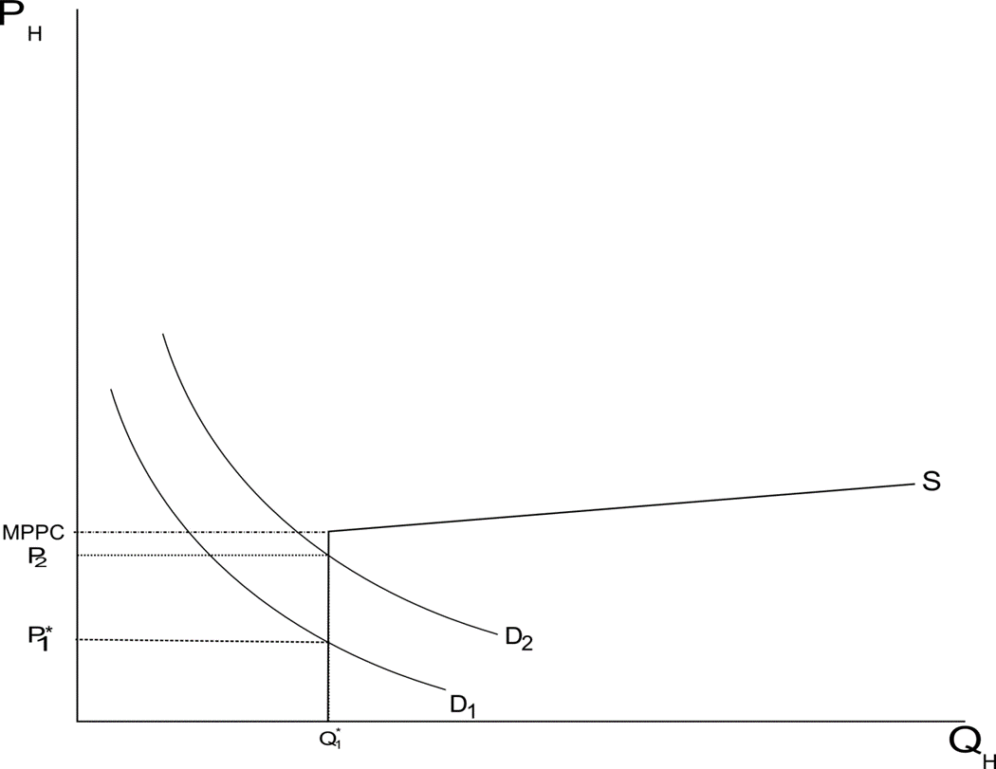

Slide 27
Compounding Challenges in Shrinking Cities

Slide 28
Shrinking Cities
As there are growing cities, there are also cities that are declining
More than 40 percent of U.S. cities (those with at least 10,000 residents) qualify as shrinking cities, having lost population between 1980 and 2010 (Bloomberg, 2019).
City of Detroit
The city used to have one of the strongest auto manufacturing industries
The city started to decline as jobs in the car manufacturing industry became scarce.
Detroit’s current population is one-third of the population at the peak.
Notes:
https://www.bloomberg.com/news/articles/2019-06-13/some-cities-are-getting-smaller-richer-and-elite

Slide 29
Compounding Challenges in Shrinking Cities
There are several traps that contribute to the further decline of shrinking cities.
1. City budget issue
2. Labor market decline
3. Vacant and abandoned home
Notes:
https://www.bloomberg.com/news/articles/2019-06-13/some-cities-are-getting-smaller-richer-and-elite

Slide 30
City Budget Issue
Most cities derive revenue mainly from property taxes and federal government funding
A decline in house prices coupled with a shrinking population significantly reduces property tax revenue
Federal government funding allocations, which are also based on population, may decrease.
With less revenue, cities face challenges in maintaining sufficient wages for police and reinvesting in infrastructure.
Furthermore, to address these financial shortfalls, the city government may need to increase property tax rates.
Notes:
https://www.bloomberg.com/news/articles/2019-06-13/some-cities-are-getting-smaller-richer-and-elite

Slide 31
City Budget Issue
Most cities derive revenue mainly from property taxes and federal government funding
A decline in house prices coupled with a shrinking population significantly reduces property tax revenue
Federal government funding allocations, which are also based on population, may decrease.
With less revenue, cities face challenges in maintaining sufficient wages for police and reinvesting in infrastructure.
Furthermore, to address these financial shortfalls, the city government may need to increase property tax rates.
Notes:
https://www.bloomberg.com/news/articles/2019-06-13/some-cities-are-getting-smaller-richer-and-elite

Slide 32
City Budget Issue
Most cities derive revenue mainly from property taxes and federal government funding
A decline in house prices coupled with a shrinking population significantly reduces property tax revenue
Federal government funding allocations, which are also based on population, may decrease.
With less revenue, cities face challenges in maintaining sufficient wages for police and reinvesting in infrastructure.
Furthermore, to address these financial shortfalls, the city government may need to increase property tax rates.
Notes:
https://www.bloomberg.com/news/articles/2019-06-13/some-cities-are-getting-smaller-richer-and-elite

Slide 33
Labor Market Decline
With shrinking populations, local companies face difficulties in finding workforce
The companies may relocate to other, growing cities
Decrease in job opportunities make the city even less attractive
The remaining population tends to be lower-income, older, and less educated, requiring more government support
With dwindling resources, the city faces limitations in reinvesting in infrastructure.
Notes:
https://www.bloomberg.com/news/articles/2019-06-13/some-cities-are-getting-smaller-richer-and-elite

Slide 34
Vacant and Abandoned Homes
Due to the aforementioned issues, selling properties becomes nearly impossible, and prices may approach $0
Residents may begin to abandon their homes without selling them
The increase in abandoned properties can make neighborhoods more dangerous and less attractive to live in
Notes:
https://www.bloomberg.com/news/articles/2019-06-13/some-cities-are-getting-smaller-richer-and-elite

Slide 35
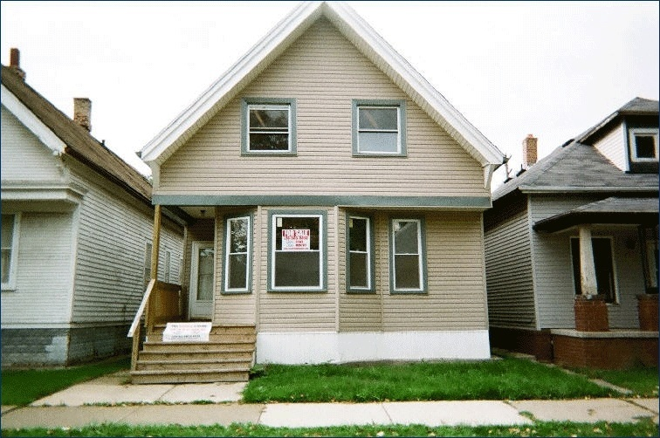

Prices Are Very Low in Detroit: This House Was Listed on Ebay for $5,000 (Sept. 9, 2010)

Slide 36
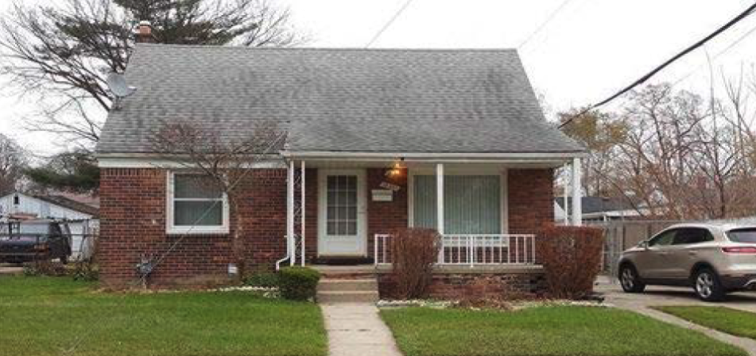
Houses in Detroit That You Could Have Bought on Realtor.com on December 9, 2016: $29,900 (900 sqft; 3BR)

Slide 37

Video Clip
Why Detroit Is Tearing Down A Highway (13:05)

Slide 38
Key Takeaways
Understand how durability of housing impact urban dynamics
Understand the 3 different types of housing markets
Understand the compounding challenges that shrinking cities face
Readings:
Edward Glaeser, (2011) Chapter 2. Why Do Cities Decline? in Triumph of the City.

